Slide 1
CerebroVision:
Advanced CNN Diagnostics for Brain Tumor Identification

Slide 2
Index
Objective and Goals
Dataset
Algorithms
Class Distribution
Optimizer
Callbacks
Implementation
Result Comparison

Slide 3
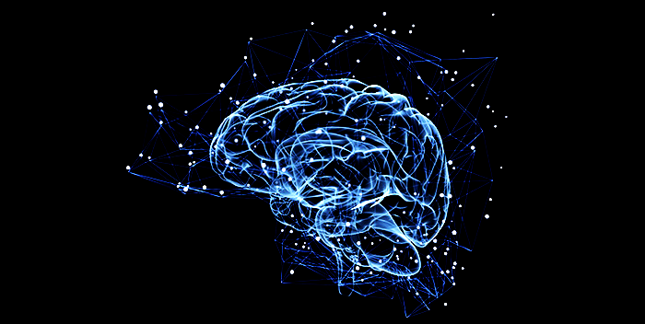
OBJECTIVE
Critical and Pressing issue in the field of medical Diagnostics
Brain Tumors - affect 25,000 to 30,000 Americans each year, with gliomas being the most common type.
Early detection and precise classification of brain tumors remain a significant hurdle.

Slide 4
OBJECTIVE
CerebroVision aims to leverage the power of Convolutional Neural Networks (CNN) to carry out the early detection and diagnosis of brain tumors. By applying advanced machine learning techniques to neuroimaging data, this project seeks to improve diagnostic accuracy and support clinicians in making informed treatment decisions.

Slide 5
GOALS
High Diagnostic Accuracy: Achieve a high level of accuracy in detecting the presence of brain tumors and classifying their types.
Early Detection: Identify tumors at early stages when they might be missed by traditional diagnostic methods.
Reduce False Negatives and Positives: Minimize false negatives to ensure patients receive timely treatment and reduce false positives to avoid unnecessary stress and procedures.

Slide 6
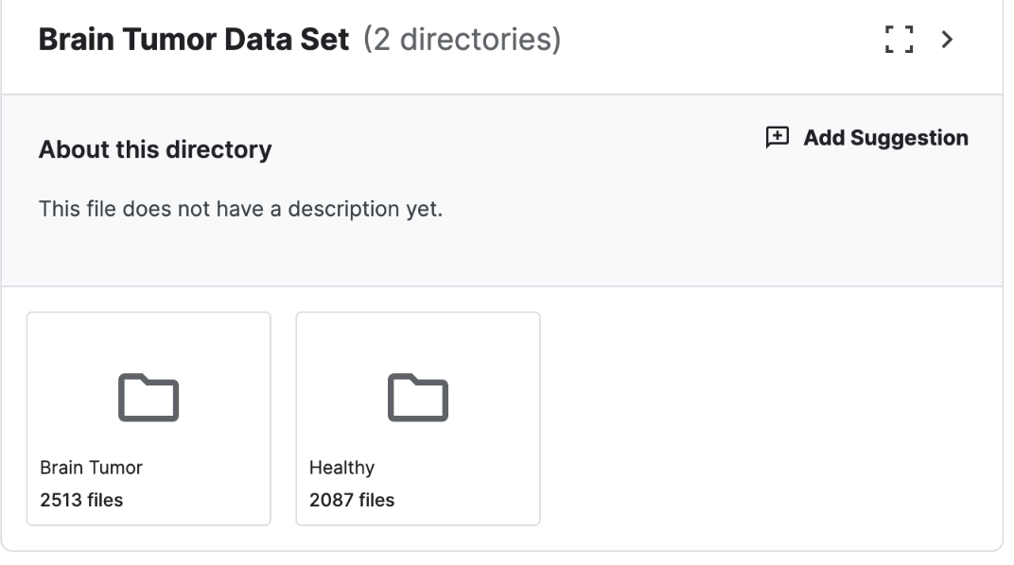
DATASET
KAGGLE BRAIN TUMOR DATASET

Slide 7
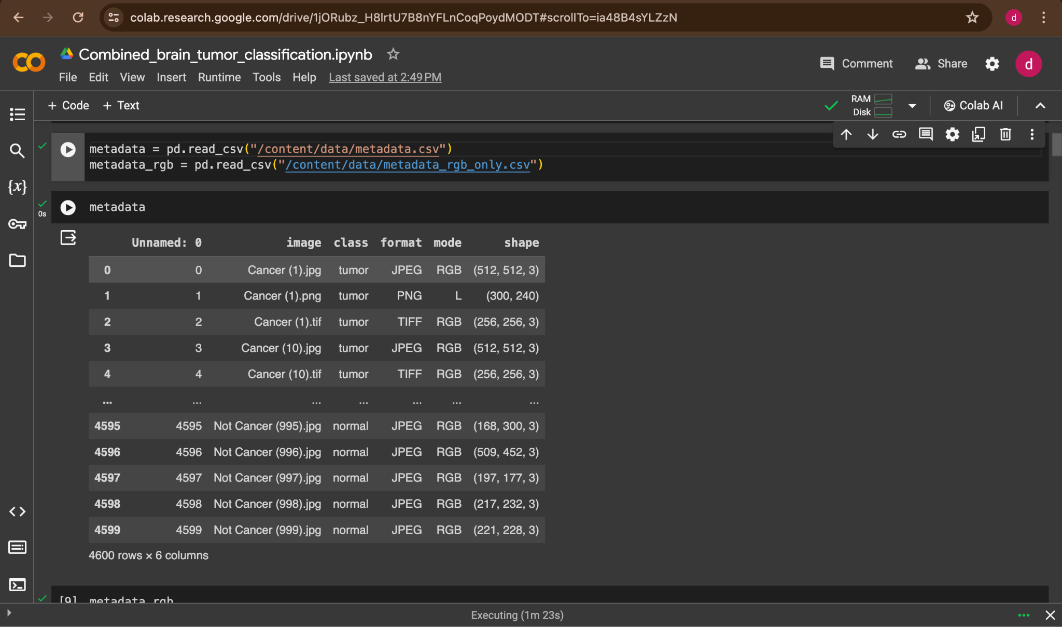
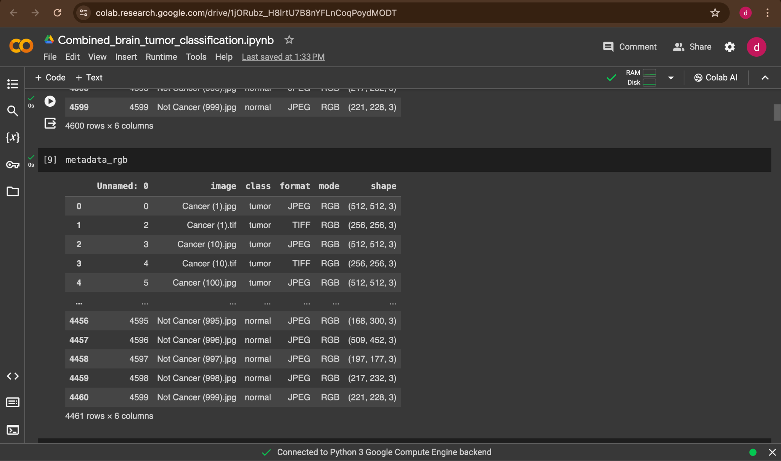
DATASET
This Dataset Consists of MRI Scans of Healthy Brain and Brain with Tumor in Black and White as well as RGB Format

Slide 8
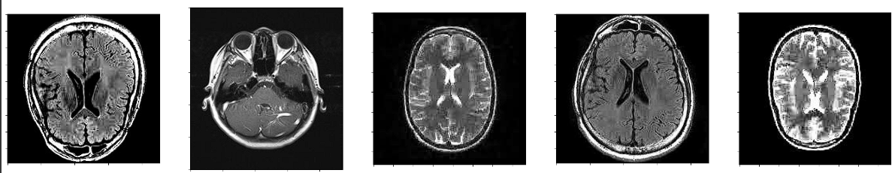
Healthy Brain

Slide 9
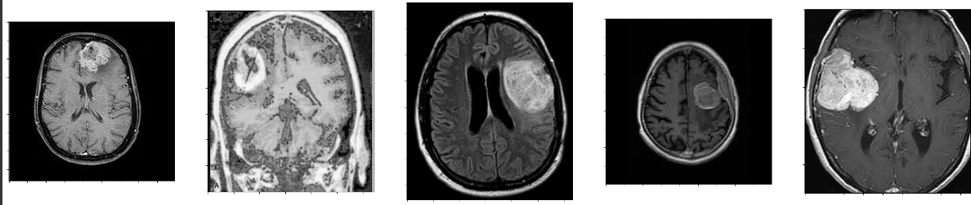
Tumor Brain

Slide 10
Algorithm
Convolutional Neural Networks (CNN) - CNNs are a class of deep neural networks, primarily used for image recognition and classification tasks. They consist of multiple layers of interconnected neurons, including convolutional layers, pooling layers, and fully connected layers.
VGG19 - VGG19 is a convolutional neural network architecture that consists of 19 layers, including convolutional layers with small 3x3 filters and max-pooling layers.
ResNet50 - ResNet50 is a variant of the ResNet (Residual Neural Network) architecture. ResNet50 specifically refers to a ResNet architecture with 50 layers, consisting of stacked residual blocks. ResNet50 is known for its ability to train very deep neural networks more effectively by mitigating the vanishing gradient problem, leading to improved performance on various image recognition tasks, including object detection and segmentation.

Slide 11
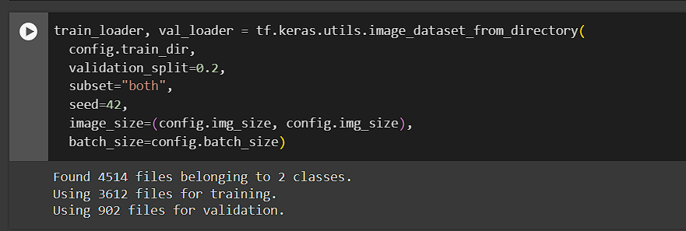
Train Test Split

Slide 12
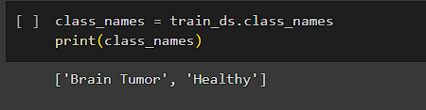
CLASS DISTRIBUTION

Slide 13
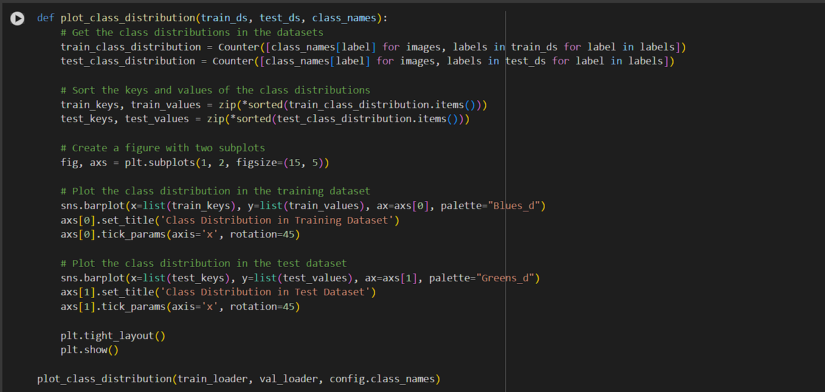
CLASS DISTRIBUTION

Slide 14
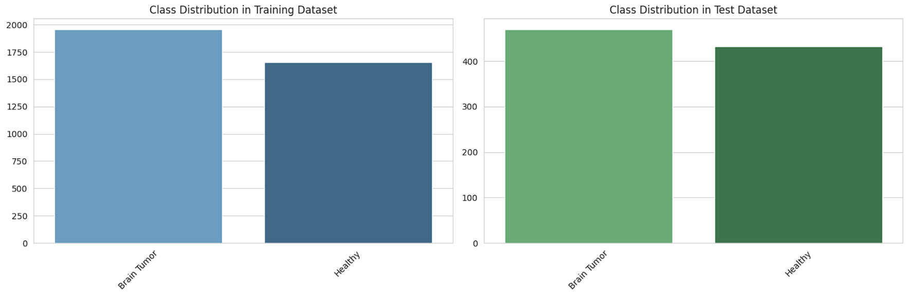
CLASS DISTRIBUTION

Slide 15
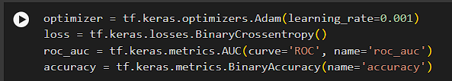
Optimizer

Slide 16
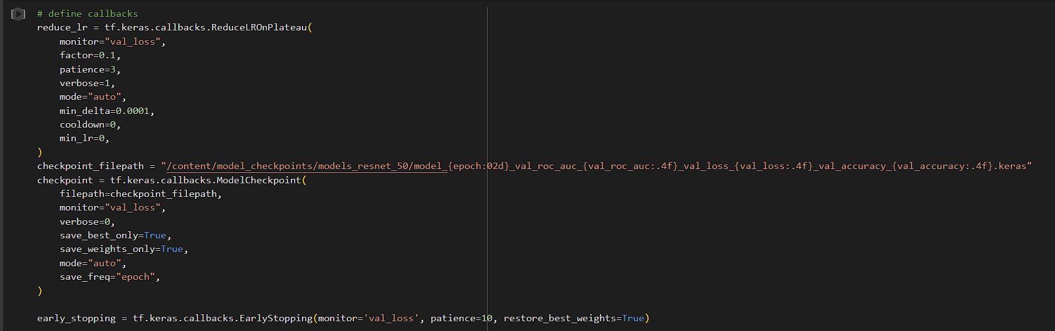
Callbacks

Slide 17
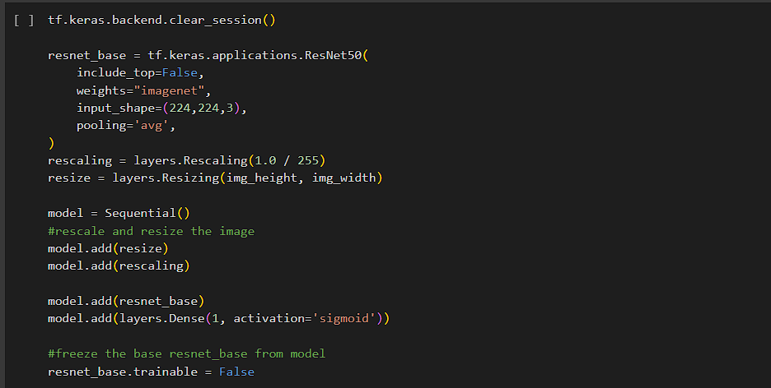
Implementation of “RESNet50” Model

Slide 18
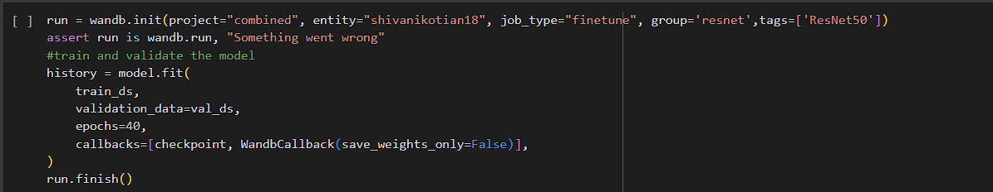
“RESNet50” Model Fitting

Slide 19
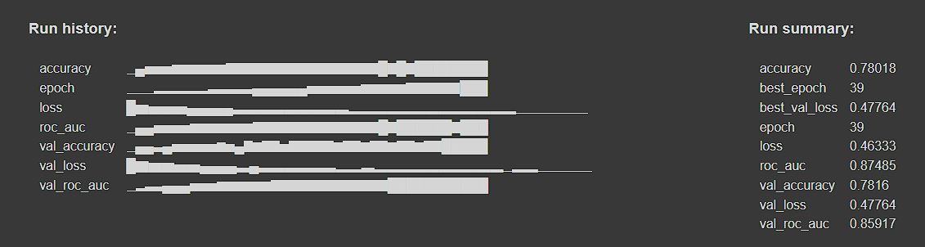
“RESNet50” Result

Slide 20
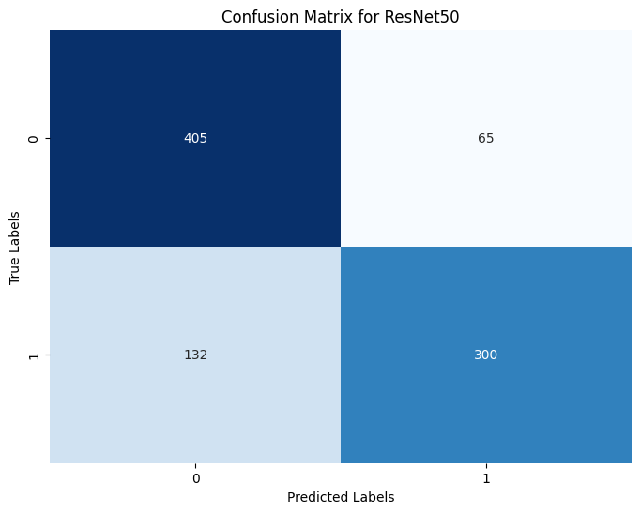
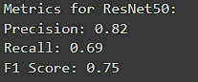
“RESNet50” Confusion Matrix

Slide 21
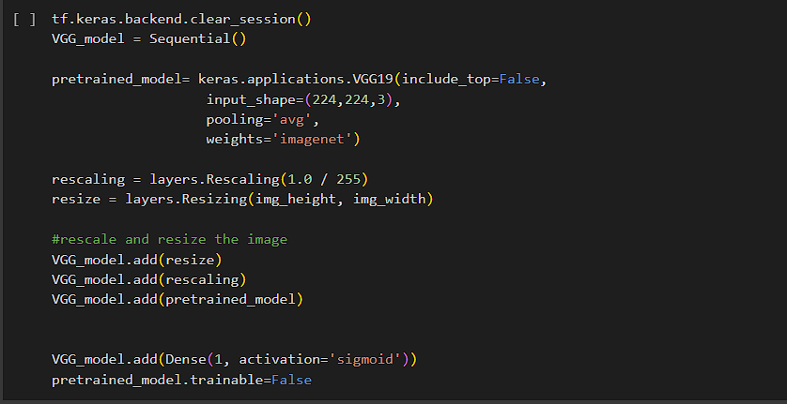
Implementation of “VGG19”Model

Slide 22
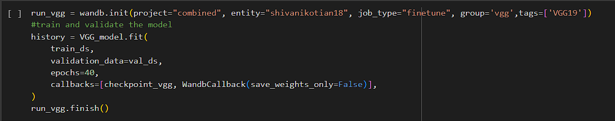
“VGG19” Model Fitting

Slide 23
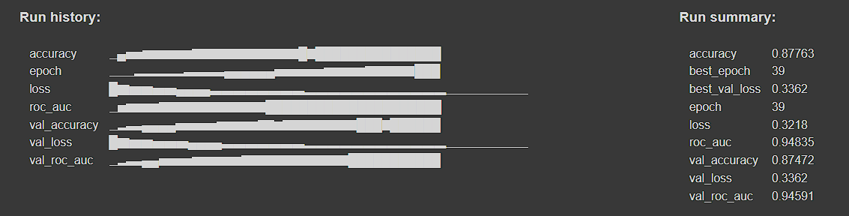
“VGG19” Result

Slide 24
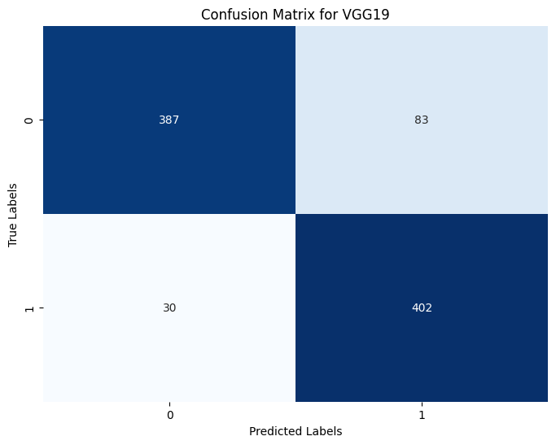
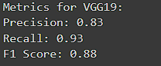
“VGG19” Confusion Matrix

Slide 25
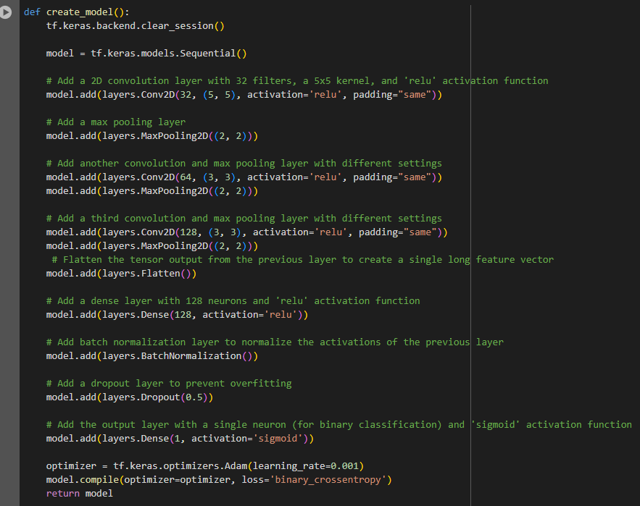
Implementation of “HALnet-1” Model
Initializing Sequential model to add layers
Adding 1st Conv2D layer which has
32 filters
5 X 5 kernel size
ReLU Activation Function (Intro Non-linearity)
Adds Max-Pooling (reduces spatial dimen)
Adding 2nd Conv2D layer which has
64 filters
3 X 3 kernel size
ReLU Activation Function
Adds Max-pooling
Adding 3rd Conv2D layer which has
128 filters
3 X 3 kernel size
ReLU Activation Function
Adds Max-pooling
Adding multiple Conv2D layers helps in capturing complex patterns, hierarchical feature extraction, feature reusability.

Slide 26
Implementation of “HALnet-1” Model
Flatten layers to flatten the tensor output from previous layer into a single long feature
Dense layer with 128 neurons and ReLU activation function
Batch Normalization to stabilize and accelerate the training by normalizing input
Dropout layer to prevent overfitting
Output layer with single neuron and sigmoid activation function for binary classification
Compiles the model with Adam optimizer and binary cross-entropy loss function for binary classification

Slide 27
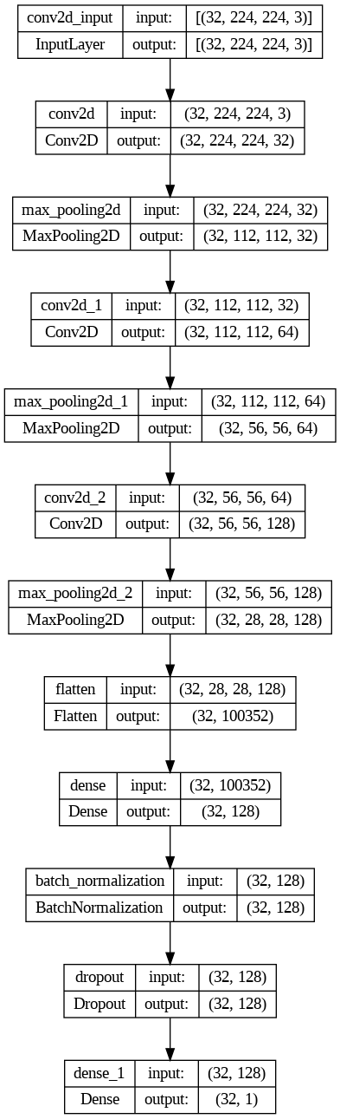
Architecture of “HALnet-1”CNN

Slide 28
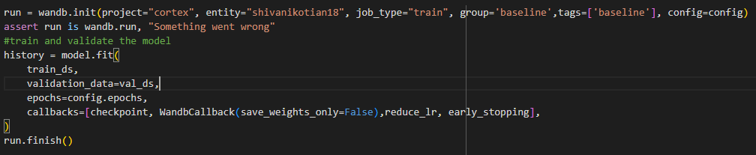
“HALnet-1” Model Fitting
Training HALnet-1 model using Weights & Biases (wandb) service for experimental tracking:
Initializes a new wandb run
Assertion - Ensures that ‘run’ object returned by ‘wandb.init()’ is correctly assigned to ‘wandb.run()’
Model Training - Trains the model using ‘train_ds’ and evaluate it on ‘val_ds’
Finish run - Marks the end of wandb run, indicating all logging and monitoring for this experiment is complete
Logs training matrices and other relevant information to wandb
Facilitates experiment tracking and visualization using wandb service

Slide 29
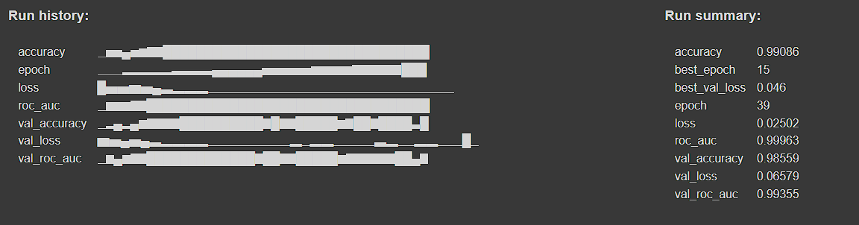
“HALnet-1” Result

Slide 30
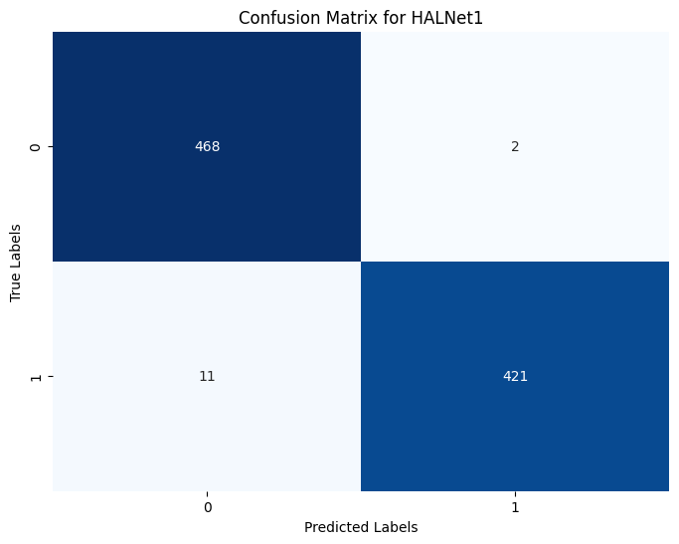
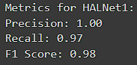
“HALnet-1” Confusion Matrix

Slide 31
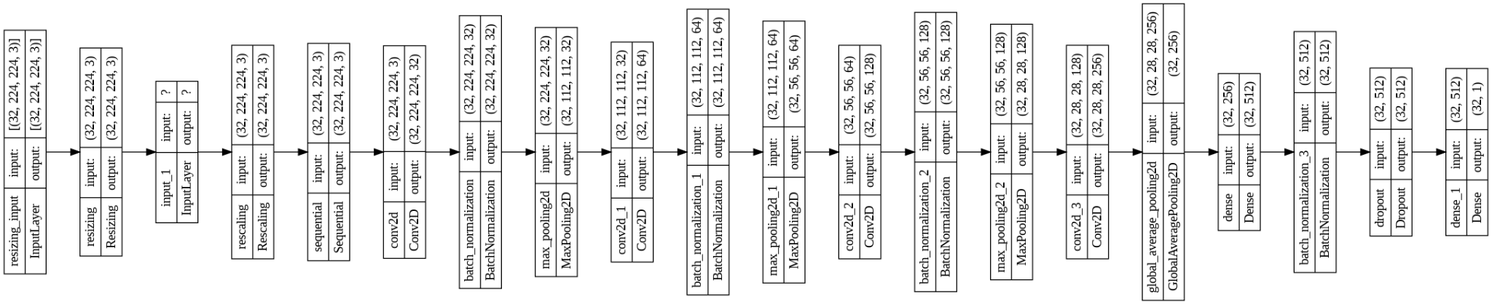
Architecture of “SMV-Net”CNN

Slide 32
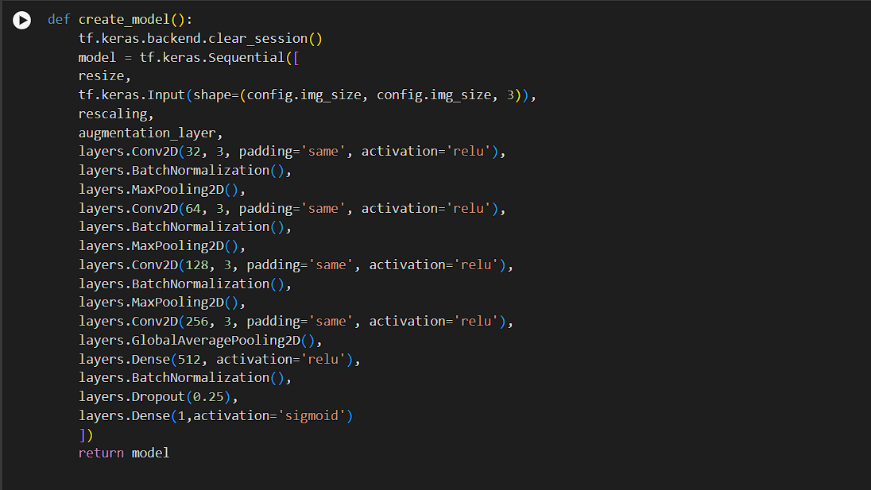
Implementation of “SMVnet” Model

Slide 33
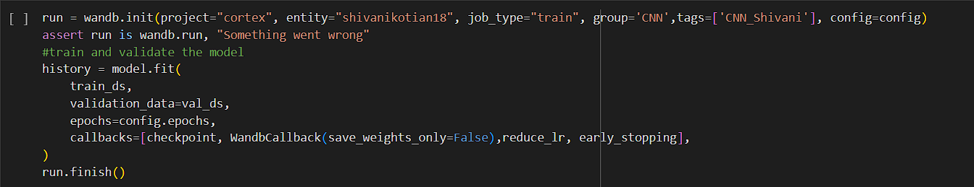
“SMVnet” Model Fitting

Slide 34
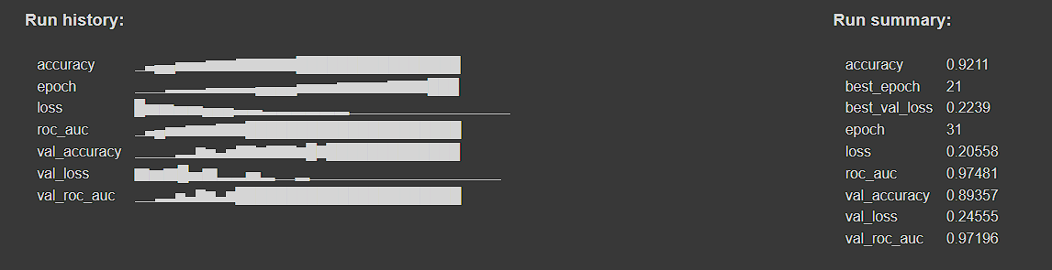
“SMVnet” Result

Slide 35
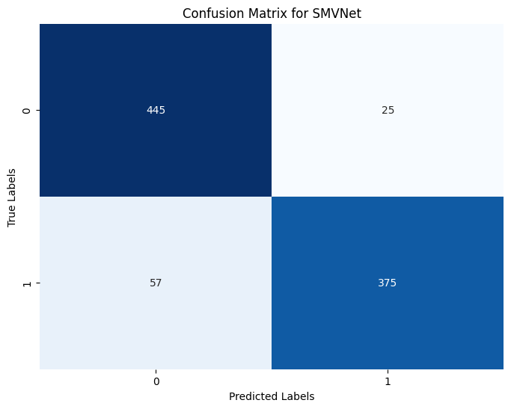
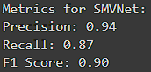
“SMVnet” Confusion Matrix

Slide 36
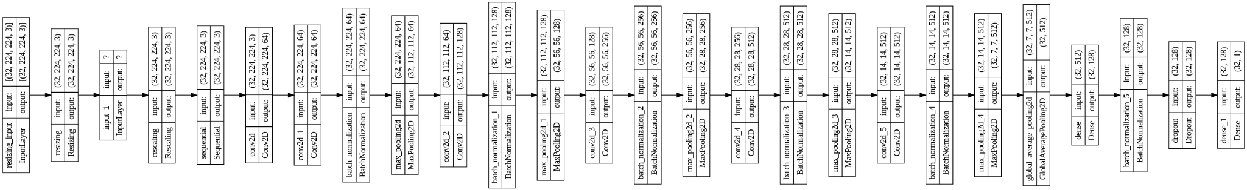
Architecture of CNN- “JAPnet”

Slide 37
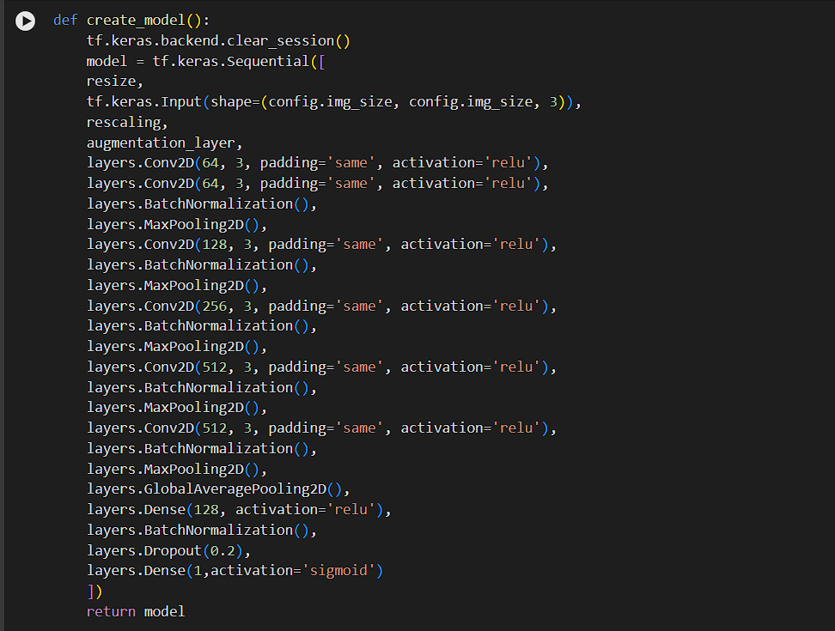
Implementation “JAPnet” Model

Slide 38
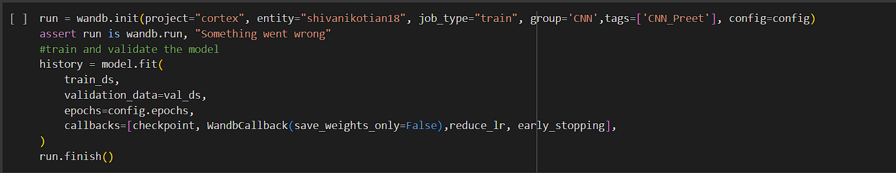
“JAPnet” Model Fitting

Slide 39
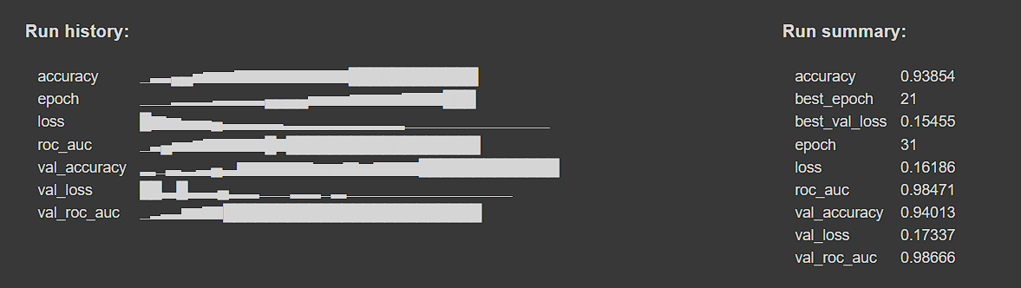
“JAPnet” Result

Slide 40

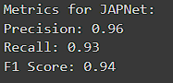
“JAPnet” Confusion Matrix

Slide 41
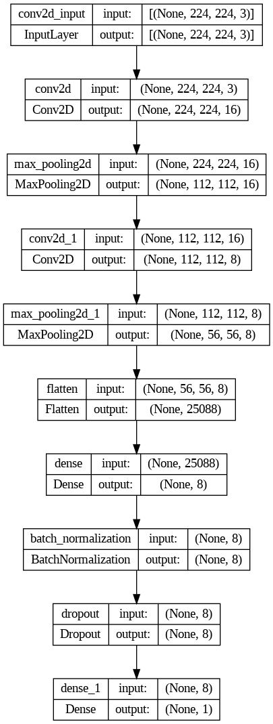
Architecture of CNN- “HALnet-2”

Slide 42
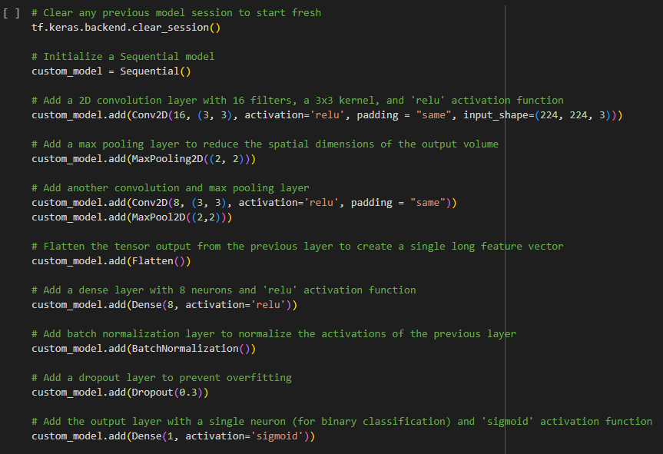
Implementation of “HALnet-2” Model

Slide 43
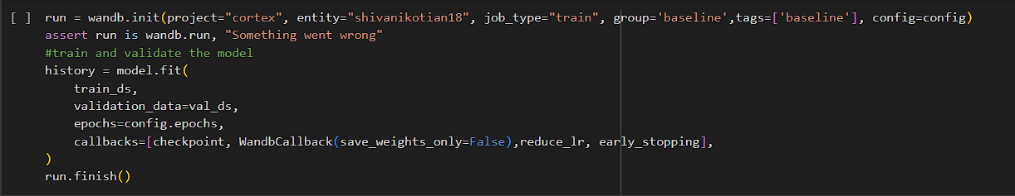
“HALnet-2” Model Fitting

Slide 44
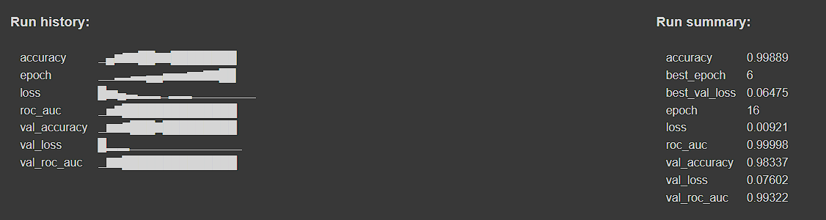
“HALnet-2” Result

Slide 45

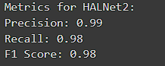
“HALnet-2” Confusion Matrix

Slide 46
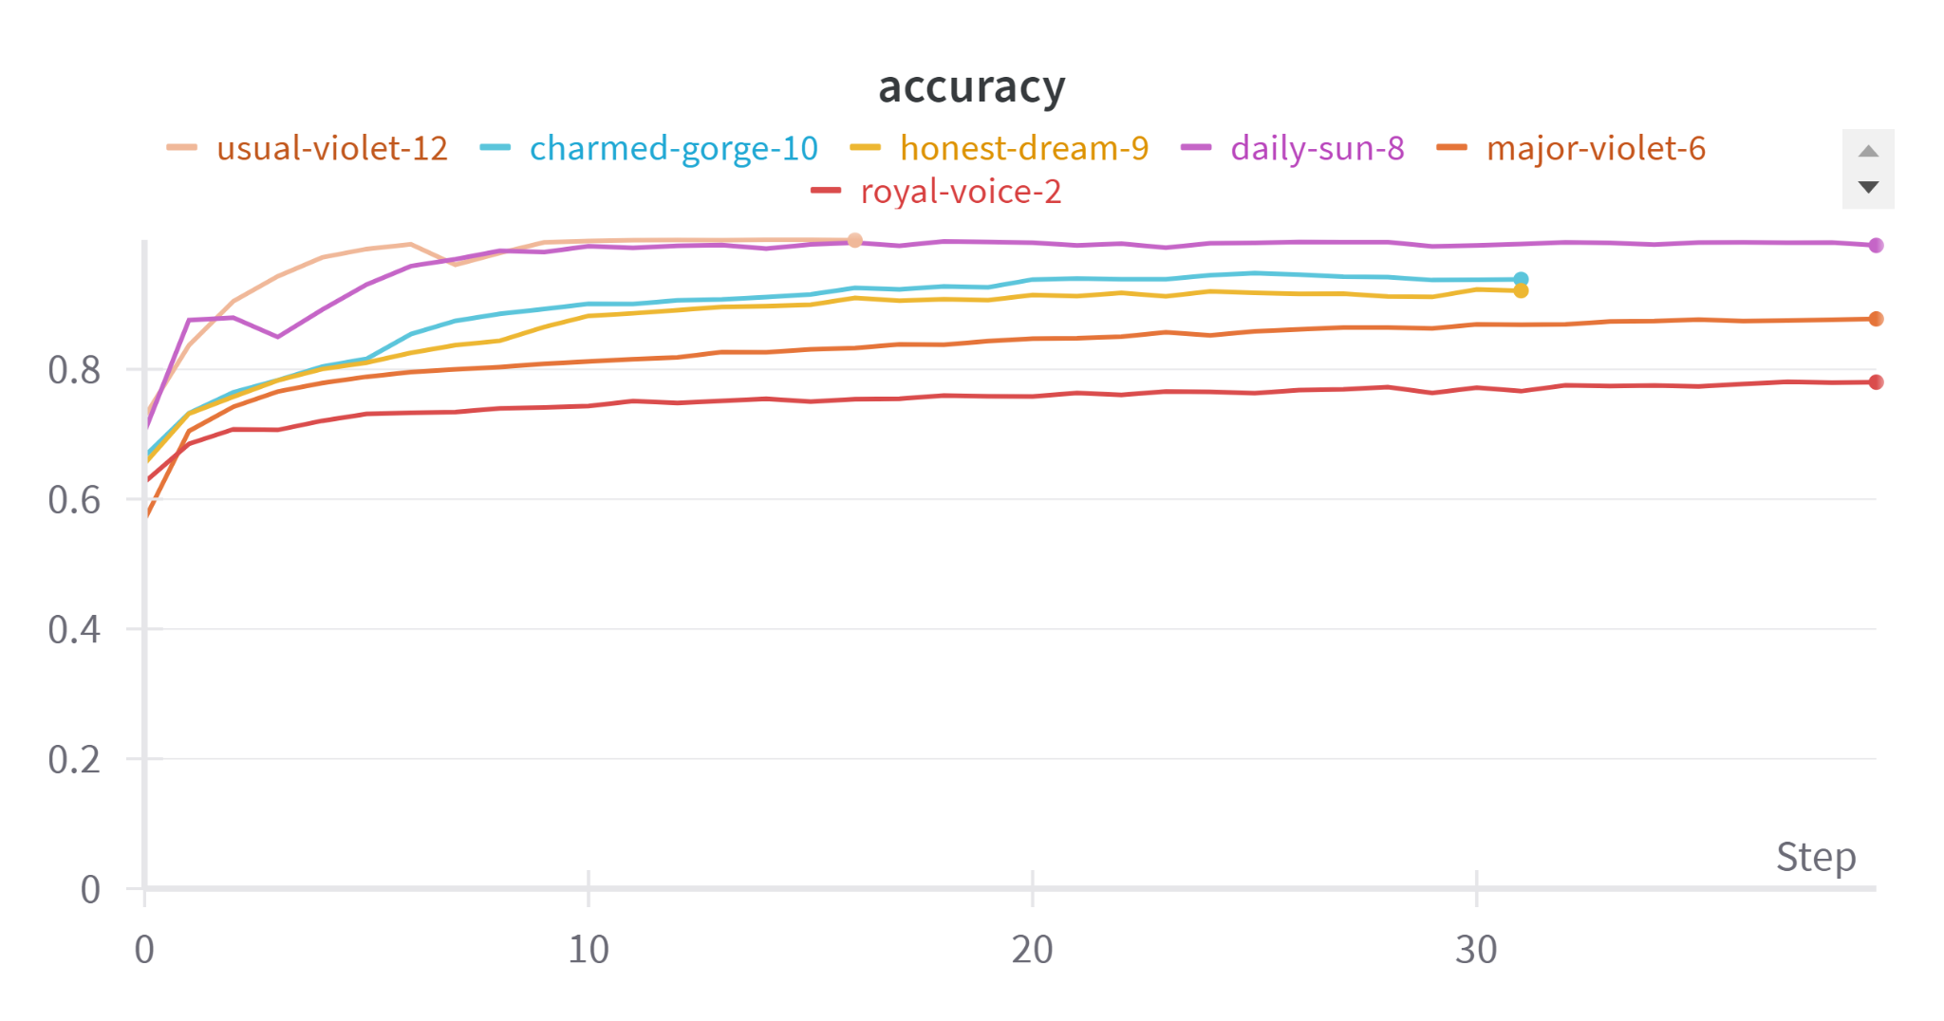
Comparison
All Models Accuracy
Resnet50 : royal-voice-2
VGG19 : Major-violet-6
HALNet-1 : daily-sun-8
SMVNet : honest-dream-9
JAPNet : charmed-gorge-10
HALNet-2 : usual-violet-12

Slide 47
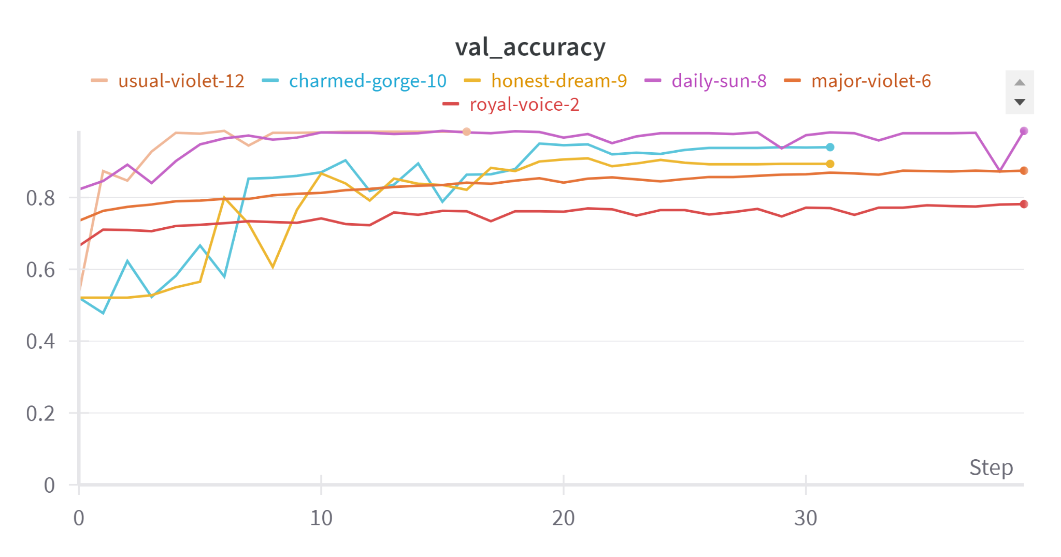
Comparison
All Models Validation Accuracy
Resnet50 : royal-voice-2
VGG19 : Major-violet-6
HALNet-1 : daily-sun-8
SMVNet : honest-dream-9
JAPNet : charmed-gorge-10
HALNet-2 : usual-violet-12

Slide 48
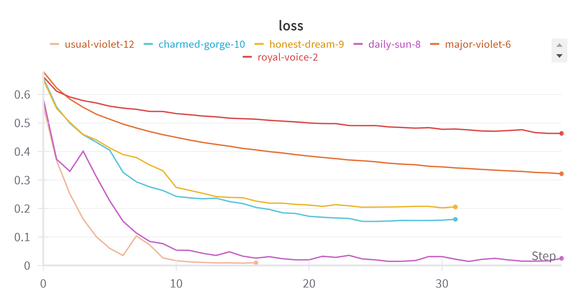
Comparison
All Models Loss Function
Resnet50 : royal-voice-2
VGG19 : Major-violet-6
HALNet-1 : daily-sun-8
SMVNet : honest-dream-9
JAPNet : charmed-gorge-10
HALNet-2 : usual-violet-12

Slide 49
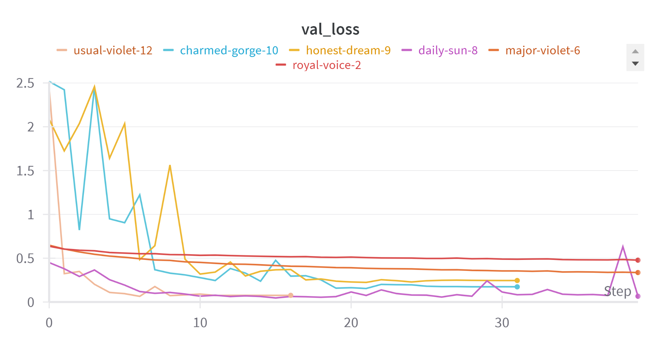
Comparison
All Models Validation Loss Function
Resnet50 : royal-voice-2
VGG19 : Major-violet-6
HALNet-1 : daily-sun-8
SMVNet : honest-dream-9
JAPNet : charmed-gorge-10
HALNet-2 : usual-violet-12

Slide 50
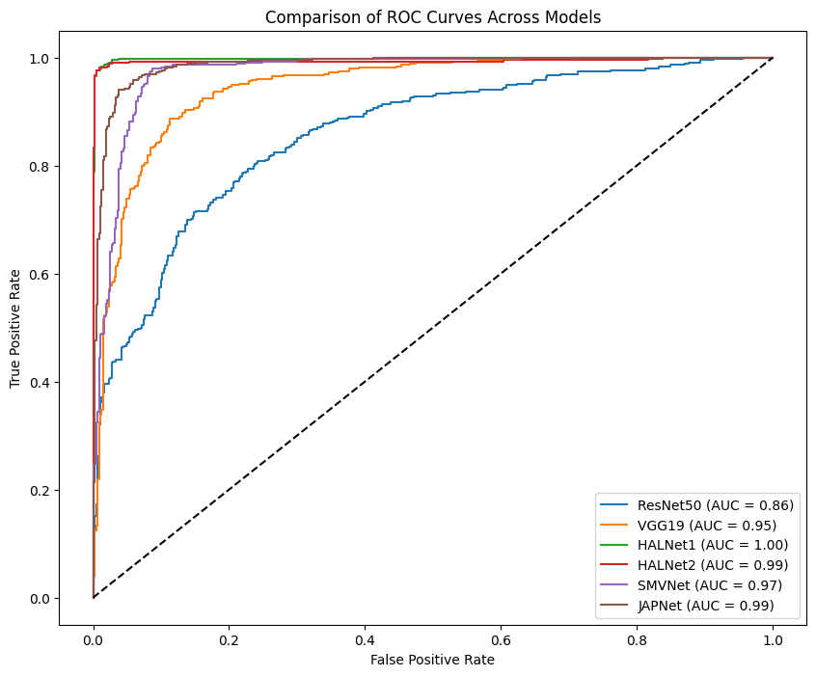
Comparison
All Models Roc Curve

Slide 51
Thank you!

